Slide 1
Business Model
Environment
Session 05
Course : Software Engineering
Effective Period : Desember 2017

Slide 2
These slides adapted f
Osterwalder, Alexander et al. 2010. Business Model Generation: A Handbook for Visionaries, Game Changers, and Challengers. JWS. New Jersey. ISBN: 978-0470-87641-1. Chapter 4
Acknowledgement

Slide 3
LO : Recognize the opportunity and idea for potential business project in the related discipline
Learning Objectives

Slide 4
Contents
Market Forces
Industry Forces
Key Trend
Macro Economic Force

Slide 5
“There’s not a single business model … There are really a lot of opportunities and a lot of options and we just have to discover all of them.”
Tim O’Reilly, CEO, O’Reilly

Slide 6
Business Model Environment
Four main areas of business model environment are:
Market forces
Industry forces
Key trends
Macroeconomic forces

Slide 7
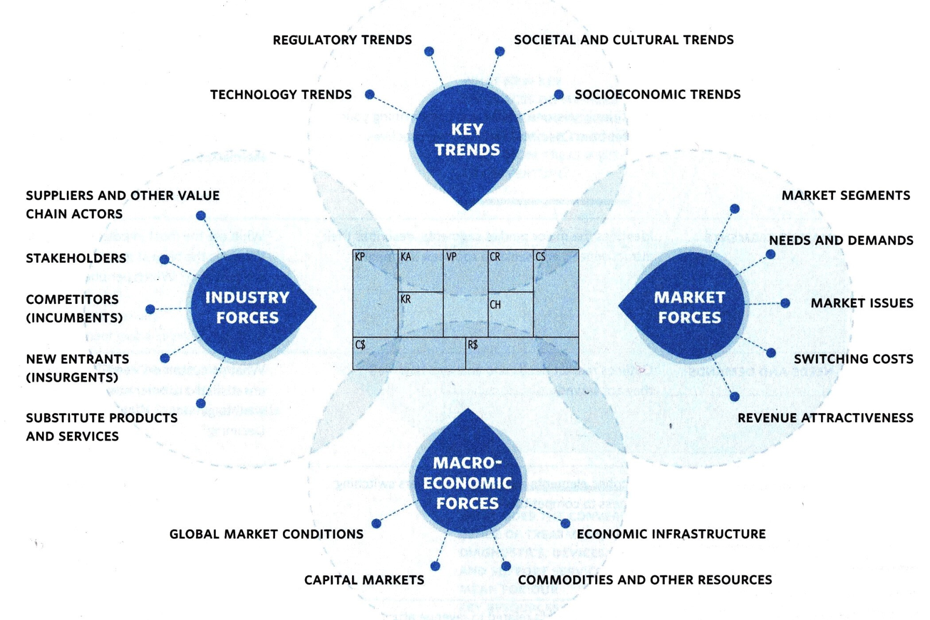
Business Model Environment

Slide 8

Market Forces
MARKET ISSUES
Identifies key issues driving and transforming your market from Customer and Offer Perspectives
Identifies the major market segments, describes their attractiveness, and seeks to spot new segments
Outlines market needs and analyzes how well they are served
Describes elements related to customers switching business to competitors
Identifies elements related to revenue attractiveness and pricing power
MARKET SEGMENTS
NEEDS AND DEMANDS
SWITCHING COSTS
REVENUE
ATTRACTIVENESS

Slide 9
Market Forces
MARKET ISSUES
  What are the critical issues affecting the customer landscape?
  What shifts are underway?
  Where is the market heading?

Slide 10
Market Forces
MARKET SEGMENTS
  What are the most important customer segments?
  Which segments have the largest growth potential?
  Which are declining?
  Which peripheral segments deserve attention?

Slide 11
Market Forces
NEEDS AND DEMANDS
What do customers need?
Where are the biggest unsatisfied needs?
What do customers really want to get done?
Where is demand increasing?
Declining?

Slide 12
Market Forces
SWITCHING COSTS
What binds customers to a company and its offer?
What switching costs prevent customers from defecting to competitors?
Is it easy to find and purchase similar offers?
How important is brand?

Slide 13
Market Forces
REVENUE ATTRACTIVENESS
What are customers really willing to pay for?
Where can largest margin be achieved?
Can customers easily find and purchase cheaper products/services?

Slide 14

Industry Forces
COMPETITITORS
(INCUMBENTS)
Identifies incumbent competitors and their relative strengths
NEW ENTRANTS
(INSURGENTS)
Indentifies new, insurgent players and determines whether they compete with a business model different from yours
Describes potential substitutes for your offer-including those from other markets and industries
SUBSTITUTE PRODUCTS
AND SERVICES
SUPPLIERS AND OTHER VALUE CHAIN ACTORS
Describes the key value chain incumbents in your market and spots new, emerging players
STAKEHOLDERS
Specifies which actors may influence your organization and business model

Slide 15
Industry Forces
Industry is relate to:
    Bargaining power of suppliers
    Bargaining powers of buyers
    Threat of new entrants
    Threat of substitutes
    Rivalry amount competitors

Slide 16
Industry Forces
Competitors
Who are our competitors?
Who are dominant ones?
What are their competitive advantages and disadvantages?
What are their main offers?
What customer segments are they focused on?
What is their cost structure?
How much influence on our customers, revenue streams and margins?

Slide 17
Industry Forces
New Entrants
Who are the new entrants in the market?
How are they different?
Competitive advantages, disadvantages?
What are their Value Propositions?
To what extent to they influence our customer segments, revenue streams, and margins?

Slide 18
Industry Forces
Substitute Products
What products or services could replace ours?
How much to they cost compared to ours?
How easy is it for our customers to switch?
How is it relate to your Business model?

Slide 19
Industry Forces
Suppliers and other value chain actors
Who are key player in our value chain?
To what extent does business model depend on other players?
Are peripheral players emerging?

Slide 20
Industry Forces
Stakeholders
Which stakeholders might influence our business model?
How influential are they?

Slide 21

Key Trends
TECHNOLOGY TRENDS
Identifies technology trends that could threaten your business model-or enable it to evolve or improve
REGULATORY TRENDS
Describe regulations and regulatory trends that influence your business modal
SOCIETAL AND CULTURAL TRENDS
Identifies major societal trends that may influence your business model
SOCIOECONOMIC TRENDS
Outlines major socioeconomic trends relevant to your business model

Slide 22
Key Trends
Technology Trends
(Technology trends that could threaten or enable it to evolve or improve)
Main tech trends inside and outside of market? E-readers, online purchase, apps, audio books
which are important opportunities or disruptive threats? apps, online purchases, concessions
which emerging tech are peripheral customer adopting? apps, smart phones

Slide 23
Key Trends
Regulatory Trends
(Regulations that influence your business model)
What trends influence your market?
What rules may affect your business model?
What regulatory affect customer demand?

Slide 24
Key Trends
Societal and Cultural Trends
(major societal trends that may influence your business model)
Describe key social trends "green" business, shop local, social consciousness, informed about environment
Which trends might influence customer behavior high gas prices

Slide 25
Key Trends
Socio Economic Trends
Key demographic trends, Buying items
Income and wealth distribution in market
Level of disposable income dropping due to recession
Spending patterns buying smaller items,
Urban or rural population

Slide 26

Macroeconomic Forces
GLOBAL MARKET CONDITIONS
Outlines current overall conditions from a macroeconomic perspective
CAPITAL MARKET
Describes current capital market conditions as they relate to your capital needs
COMMODITIES AND OTHER RESOURCES
Highlights current prices and price trends for resources required for your business model
ECONOMIC INFRASTRUCTURE
Describes the economic infrastructure of the market in which your business operates

Slide 27
Macroeconomic Forces
Global market conditions
(current overall conditions from a macroeconomic perspective)
Boom or bust BUST
general market sentiment CAUTIOUS, UNCERTAIN
unemployment rate DOUBLE DIGITS

Slide 28
Macroeconomic Forces
Capital markets
(current capital market conditions as they relate to your capital needs)
low interest rate paid on investments
low interest rates for borrowing relatively low

Slide 29
Macroeconomic Forces
Commodities and other resources
(current prices and price trends for resources required for you business model)
  High oil prices makiing gas prices high
  Late openind of GTSR requires less inventory, economies of scale lower,
  Publishing prices staying same So far.

Slide 30
Macroeconomic Forces
Economic Infrastructure
(infrastructure of market)
  How good is public infrastructure?
  GTSR under repair, shuttle service, state roads not best
  access to suppliers limited by location fo agencies
  excellent quality of life

Slide 31
References
Osterwalder, Alexander et al. 2010. Business Model Generation: A Handbook for Visionaries, Game Changers, and Challengers. JWS. New Jersey. ISBN: 978-0470-87641-1.
http://tmp.ucsb.edu/outreach/nvc_files/pdf/Jan22_BusinessModelEnvironment.pdf
http://businessmodelcanvas.wikispaces.com/Business+Model+Environment+-+Market+Forces
http://businessmodelcanvas.wikispaces.com/Business+Model+Environment+-+Industry+Forces
http://businessmodelcanvas.wikispaces.com/Business+Model+Environment+-+Key+Trends

Slide 32
Q & A

